Slide 1
AI NEWS SUMMARIZER
Subject :
NAAN MUDHALVAN
Submit by :
DEVI K
MADRAS INSTITUTE OF TECHNOLOGY
COMPUTER SCIENCE STUDENT

Slide 2

02
OVERVIEW
01
02
03
04
PROBLEM STATEMENT
OBJECTIVES
PROPOSED SYSTEM/SOLUTION
SYSTEM APPROACH
05
06
07
08
ALGORITHM AND DEPLOYMENT
IMPLEMENTATION
RESULT
CONCLUSION
09
REFERENCES

Slide 3
03
PROBLEM STATEMENT
The project aims to create a news summarizer application using Python's Tkinter library. It employs the Newspaper library for article parsing and TextBlob for text summarization and sentiment analysis.The primary goal is to create a user-friendly interface that enables users to quickly obtain summarized news content and relevant insights.

Slide 4
04
OBJECTIVES
SUMMARIZATION
Develop a system that extracts the content of a news article from a provided URL and generates a concise summary of the article.
INFORMATION EXTRACTION
Extract relevant information such as the article's title, author, and publishing date .
SENTIMENT ANALYSIS
Analyze the sentiment of the article's content and present it as either positive, negative, or neutral .

Slide 5
05
PROPOSED SYSTEM/SOLUTION
NATURAL LANGUAGE PROCESSING(NLP) :
Article Processing:
Utilize the Newspaper library to download, parse, and analyze the content of the news article from the provided URL.
Text Summarization:
Employ natural language processing techniques to generate a summary of the article's content, ensuring that the key points are captured accurately.
Sentiment Analysis:
TextBlob library is employed for sentiment analysis. It calculates the polarity of the article's text, indicating whether the sentiment is positive, negative, or neutral.

Slide 6
06
SYSTEM APPROACH
HARDWARE REQUIREMENTS
1
Standard laptop /computer
2
Memory(RAM)
3
Internet connection
4
Storage

Slide 7
07
SOFTWARE REQUIREMENTS
1
Python
2
Tkinter
3
Newspaper library
4
TextBlob library

Slide 8
08
ALGORITHM AND DEPLOYMENT
User Interface Design:
Create a GUI using Tkinter to design the user interface with labels, text entry fields, and a button.
Include text entry field for users to input the URL of the news article.
Add labels for displaying the article's title, author, publishing date, summary, and sentiment analysis results.
Implement a "Summarize" button to trigger the summarization and analysis process.
Article Processing:
Retrieve the URL inputted by the user.
Utilize the Newspaper library to download, parse, and extract the content of the news article from the provided URL.
Ensure error handling for invalid URLs or failed article retrieval.

Slide 9
09
ALGORITHM AND DEPLOYMENT
Text Summarization:
Use natural language processing techniques to generate a summary of the article's content.
Employ the article.summary() function provided by the Newspaper library to automatically generate a summary of the article's main points.
Sentiment Analysis:
Utilize TextBlob to perform sentiment analysis on the article's content.
Calculate the polarity of the article's text to determine whether the sentiment is positive, negative, or neutral.
Display the sentiment analysis results, including the polarity score and sentiment label (positive, negative, neutral), in the designated text entry field in the GUI.

Slide 10
10
ALGORITHM AND DEPLOYMENT
User Interaction:
Implement event handling for the "Summarize" button to trigger the summarization and analysis process when clicked.
Disable input fields and buttons during processing to prevent user interaction until the process is complete.
Enable input fields and buttons after processing is finished to allow users to input new URLs or trigger the process again.
Error Handling:
Implement error handling to handle exceptions such as invalid URLs, failed article retrieval, or errors during text processing.
Display error messages or notifications to the user if any errors occur during the process.

Slide 11
11
IMPLEMENTATION
PHASE 01
PHASE 02
PHASE 03
User Interface Development
Article Summarization
Sentiment Analysis
Design and create a graphical user interface (GUI) using Python's Tkinter library to accept the URL input from the user.
Utilize the Newspaper library to parse the news article from the URL, employ text summarization techniques to condense the content into a concise summary, capturing key points effectively.
Implement TextBlob to analyze the sentiment of the summarized article, assigning polarity scores to words and phrases.

Slide 12
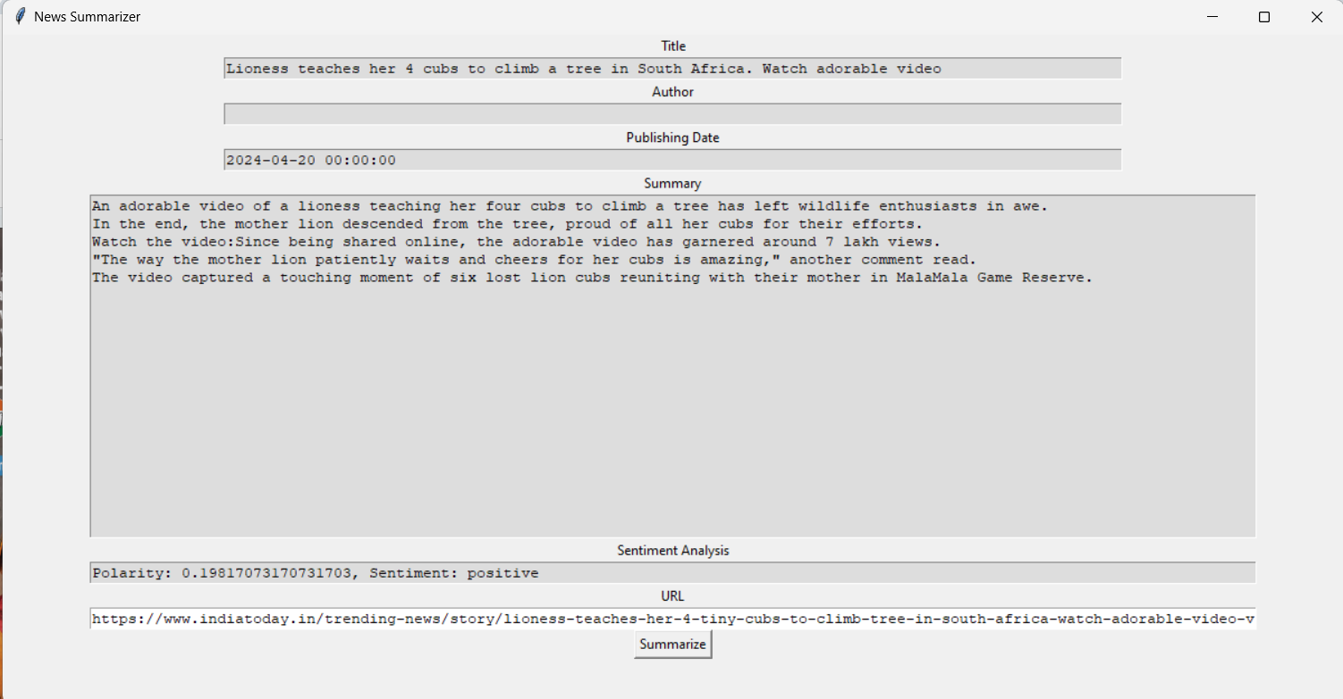
12
RESULT

Slide 13
13
CONCLUSION
In conclusion, this project demonstrates the integration of generative AI techniques within a news summarization application to enhance its functionality and usability. By leveraging natural language processing (NLP) capabilities offered by libraries such as TextBlob and Newspaper, the application is able to effectively extract, analyze, and summarize the content of news articles provided via URL.

Slide 14
14
REFERENCES
Newspaper Documentation
https://newspaper.readthedocs.io/en/latest/
TextBlob Documentation
https://textblob.readthedocs.io/en/dev/

Slide 15
Finish
THANK YOU

